Slide 1
Jermyn Borough Council Meeting
12/16/21

Slide 2

Meeting Agenda
December 16, 2021
CALL TO ORDER
PLEDGE OF ALLEGIANCE
ROLL CALL
PREVIOUS MEETING MINUTES(11/18/21)
TREASURER REPORT/BILLS PAYABLE
CORRESPONDENCE
PUBLIC COMMENT
PROFESSIONAL REPORTS
COMMITTEE REPORTS
CYBER INSURANCE
MS4 ADVERTISING OF PRP
LSA GRANT RESOLUTION 15-2021
CIVIL SERVICE
2022 BUDGET
FOLLOW UP NEIC/HOUSER
BUILDING ELEVATOR
LOFF SUBDIVISION
INDEPENDENT AUDITOR RESOLUTION 16-2021
TAX MILLAGE RATE RESOLUTION 17-2021
ORG MEETING 1/3/22
SET 2022 MEETING DATES

Slide 3
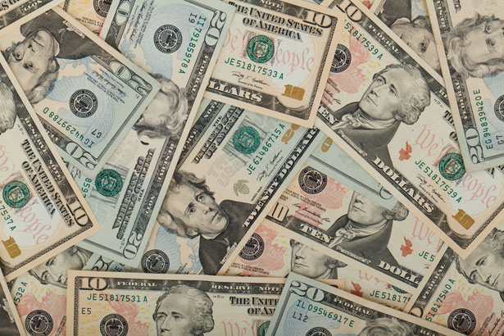
Treasurer’s report
12/16/21
ASSETS
Checking/Savings
Capital Reserve - DPW 10,725.40
Capital Reserve - Police 4,551.82
Crime Watch Fund 222.69
General Fund - Community 76,305.44
General Fund - FNB 4,484.45
Holiday Lights Fund 1,881.14

Slide 4
Treasurer’s report
Investment - General Fund 1,001.58
Investment - Liquid Fuels 33,815.77
Investment - Paving Fund 1,011.94
Investment - Recycling 5,003.67
Investment - Refuse 2,600.35
Liquid Fuels - FNB 24,850.87
Petty Cash 231.00
Recreations Fund 16,132.98
Recycling - Community 8,673.76
Refuse Checking - FNB 47,963.80
Total Checking/Savings 239,456.66

Slide 5
Treasurer’s report
200000 · Accounts Payable 27,014.96

Slide 6
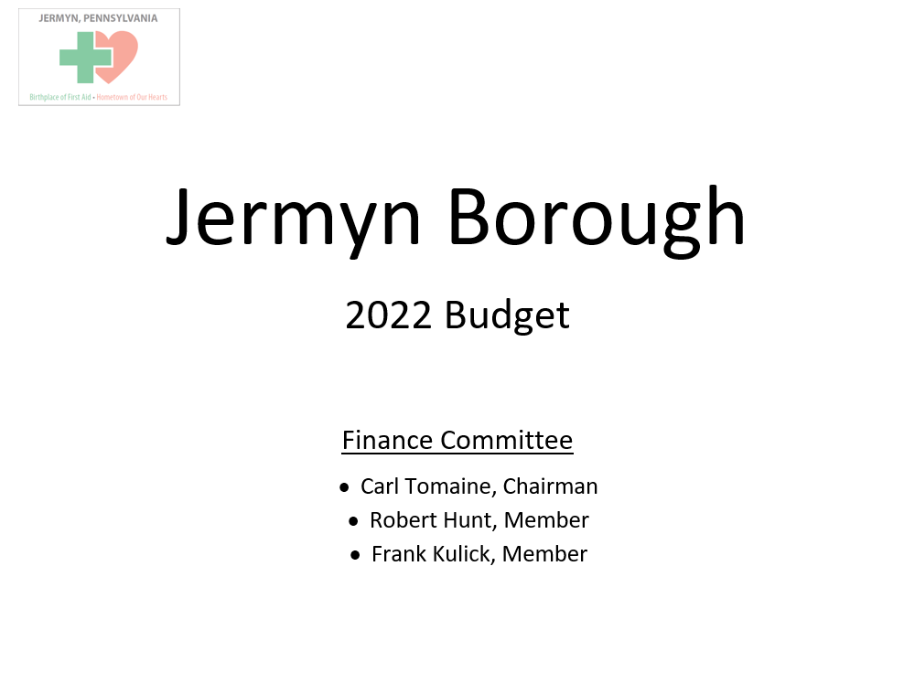

Slide 7
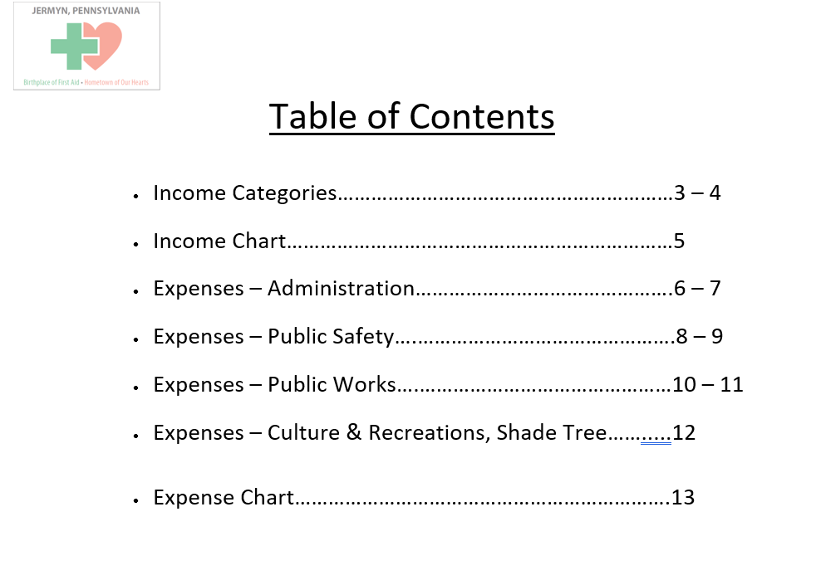

Slide 8
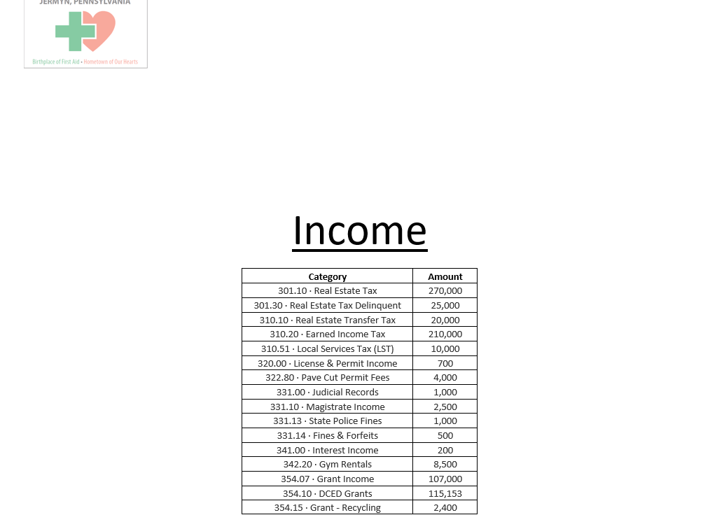

Slide 9
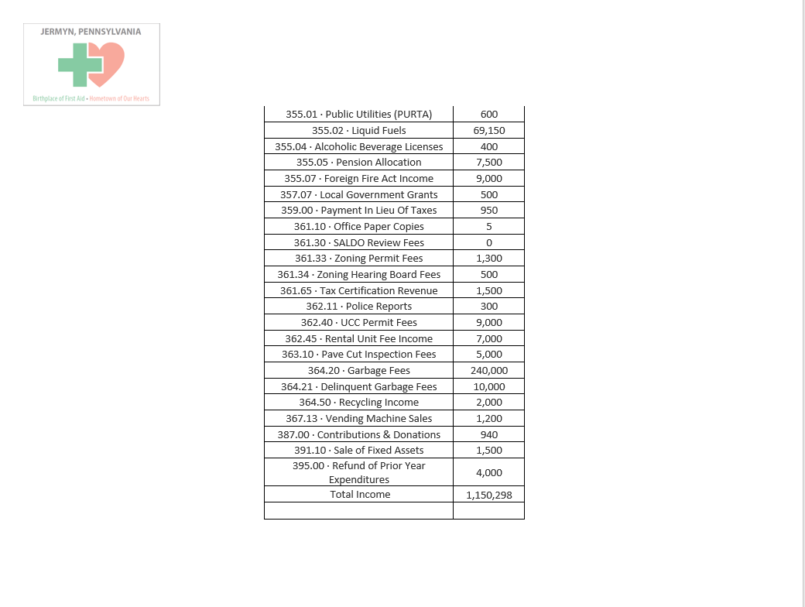

Slide 10
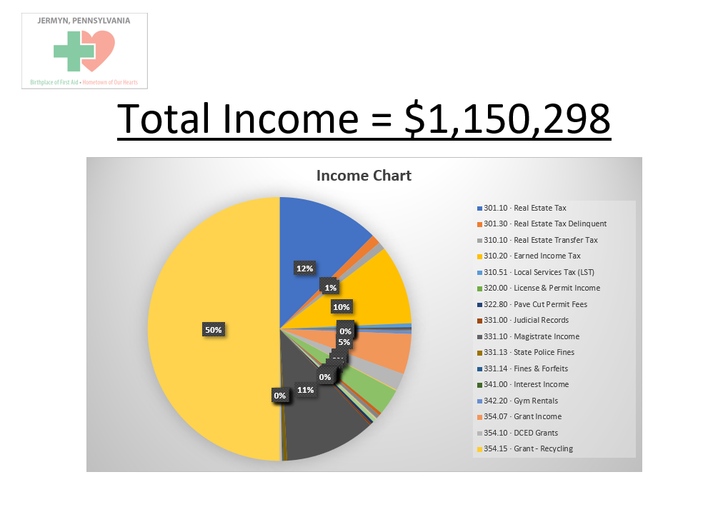

Slide 11
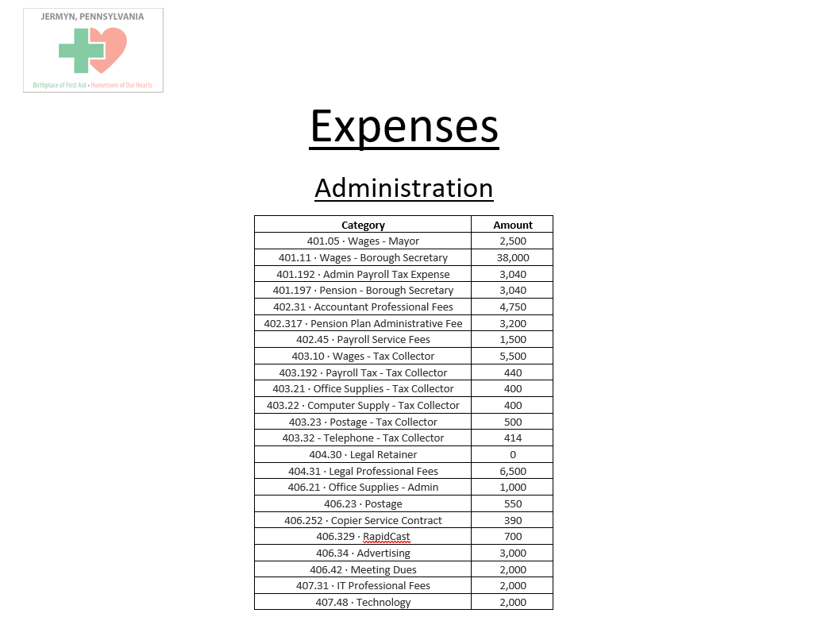

Slide 12
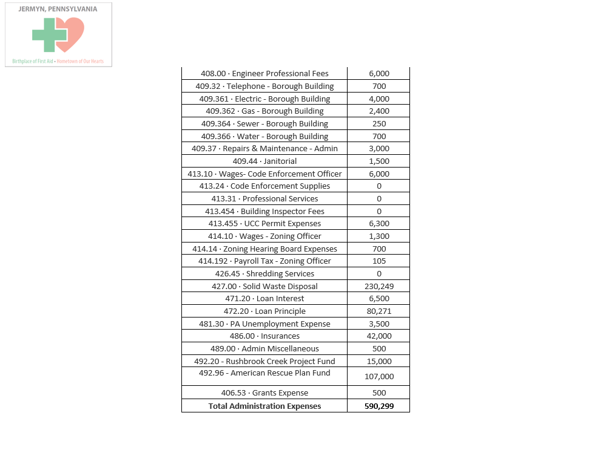

Slide 13
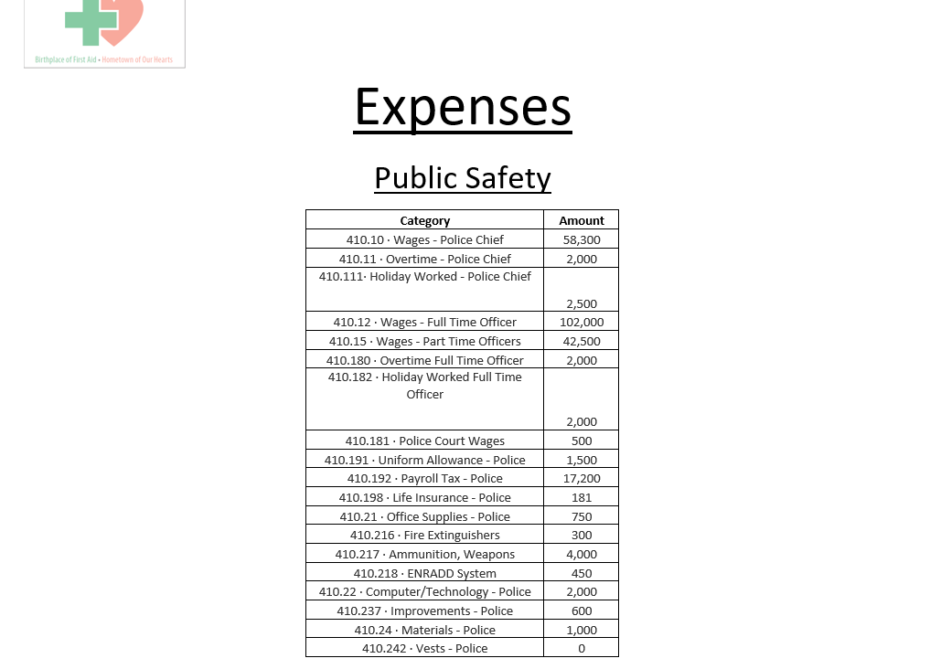

Slide 14
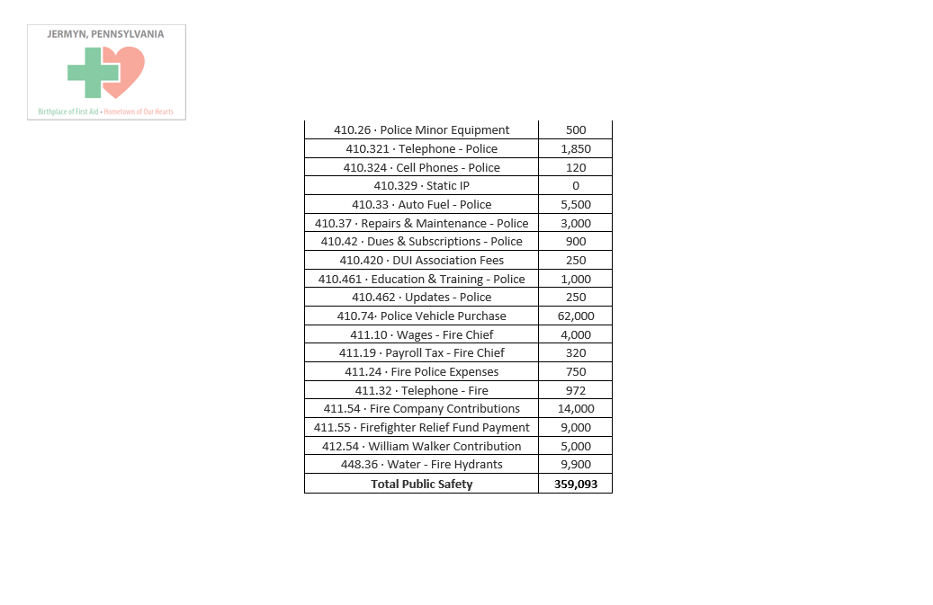

Slide 15
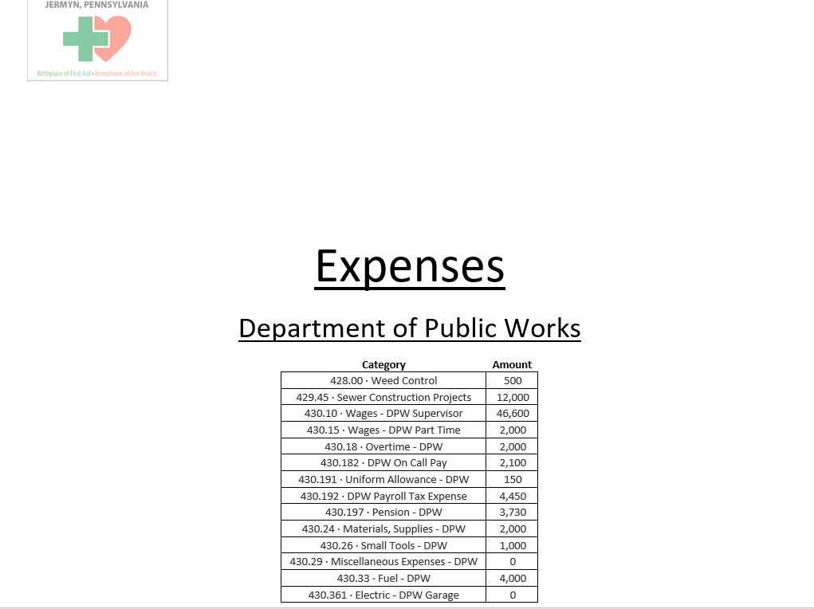

Slide 16
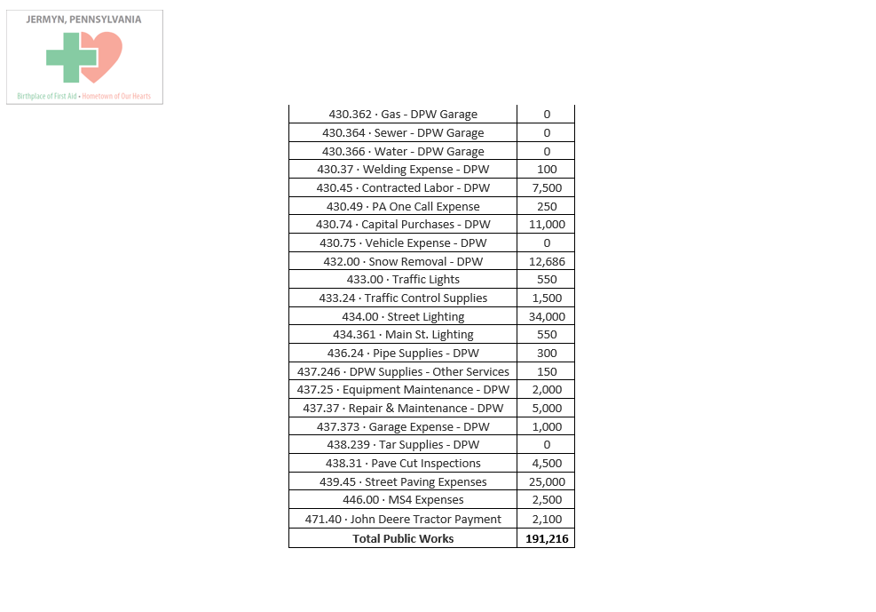

Slide 17
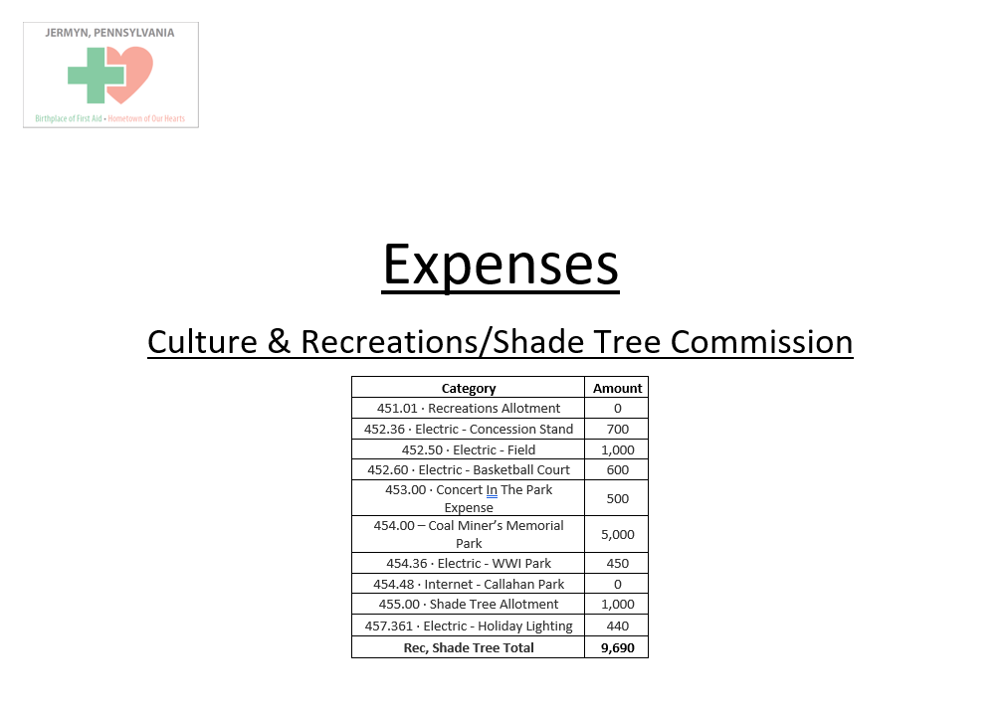

Slide 18
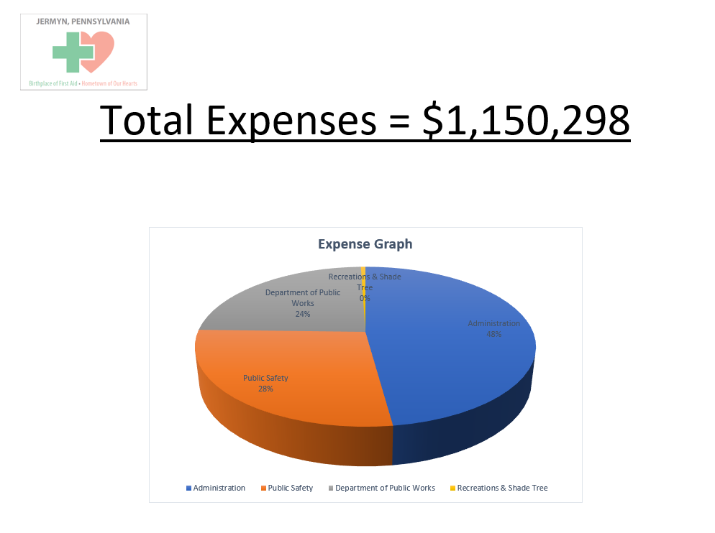

Slide 19


